Slide 1
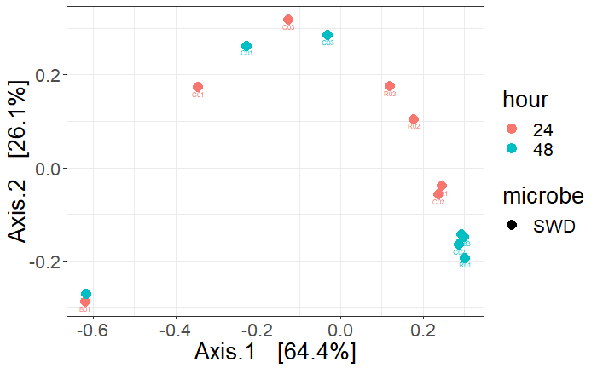
Blanks
Controls
Replicates

Slide 2
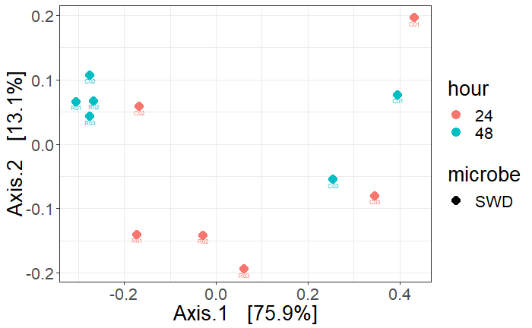
Controls
Replicates

Slide 3
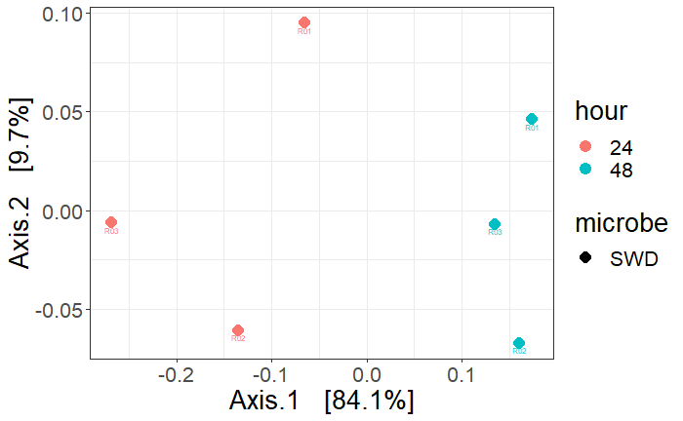
Multidimensional scaling (MDS) using principal coordinates analysis (PCoA) of a Bray-Curtis distance matrix comparing the volatile composition of strawberries 24 hours (red) and 48 hours (blue) after foraging by SWD. Strawberries were collected from organic plots in Citra, FL and exposed to SWD flies for 1 hour. After foraging, flies were removed from the fruit and the fruit was sealed into a volatile collection chamber for the duration of the trial. Each marker represents the bouquet of volatiles collected from each of the foraged strawberries. Axis.1 explained 84.1% of the variance and Axis.2 explained 9.7% of the variance.

Slide 4
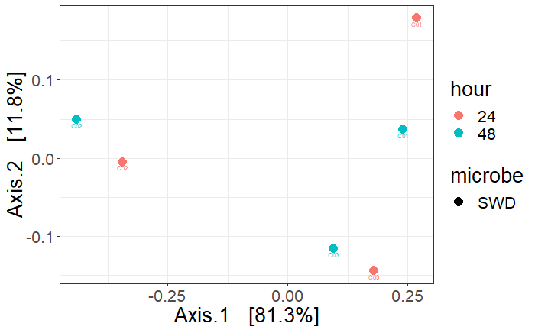
Controls
ONLY

